Slide 1
Financial Statement Analysis
Mentor : Prof. Ratnakar Pandey
Presented by
Amit Kavnekar
Madhukeshwar
Hitesh
Anand Mohan

Slide 2
We note that Liabilities have decreased for Apple over the last one year for other companies the liabilities have increased gradually
Google has highest % increase in liabilities 35% followed by Netflix at 27%
 | Total liabilities
 | Netflix | DELL | INTEL | GOOGLE | APPLE
30-1-2017 | 1,09,06,810 | 9,89,66,000 | 4,62,19,000 | 2,84,61,000 | 19,34,37,000
30-1-2018 | 1,54,30,786 | 10,69,10,000 | 5,33,64,000 | 4,47,93,000 | 24,12,72,000
30-1-2019 | 2,07,35,635 | 11,15,66,000 | 5,29,81,000 | 5,51,64,000 | 25,85,78,000
30-1-2020 | 2,63,93,555 | 11,50,77,000 | 5,88,65,000 | 7,44,67,000 | 24,80,28,000
%change in last 1 year | 27.2859741 | 3.147016116 | 11.1058681 | 34.99202378 | -4.080006806

Slide 3
The total assets have increased significantly for google over last four years.
For apple the is a gradual decline in overall assets over last three years
for other companies there the assets have increased gradually.
Netflix has highest % growth of assets over last 1 year
 | Total Assets
 | Netflix | DELL | INTEL | GOOGLE | APPLE
30-1-2017 | 1,35,86,610 | 11,82,06,000 | 11,33,27,000 | 16,74,97,000 | 32,16,86,000
30-1-2018 | 1,90,12,742 | 12,22,81,000 | 12,32,49,000 | 19,72,95,000 | 37,53,19,000
30-1-2019 | 2,59,74,400 | 11,18,20,000 | 12,79,63,000 | 23,27,92,000 | 36,57,25,000
30-1-2020 | 3,39,75,712 | 11,88,61,000 | 13,65,24,000 | 27,59,09,000 | 33,85,16,000
%change in last 1 year | 30.804608 | 6.296726882 | 6.69021514 | 18.52168459 | -7.43974298

Slide 4
Netflix and Apple have shown highest % growth in terms of Total cash holding over last one year
Total cash has declined for Dell
 | Total CASH
 | Netflix | DELL | INTEL | GOOGLE | APPLE
01-01-2019 | 37,94,483 | 96,76,000 | 1,16,50,000 | 10,91,40,000 | 6,36,01,000
01-01-2020 | 50,18,437 | 93,02,000 | 1,31,23,000 | 11,96,75,000 | 10,05,57,000
%change in last 1 year | 32.2561466 | -3.86523357 | 12.64377682 | 9.652739601 | 58.10600462

Slide 5
Profit for all companies has grown gradually.
In terms of % growth Netflix has shown the highest growth Gross profit growth of 14% over last 1 year
 | GROSS Profit
 | Netflix | DELL | INTEL | GOOGLE | APPLE
2016 | 28,00,768 | 1,29,59,000 | 3,61,91,000 | 5,51,34,000 | 8,42,63,000
2017 | 40,33,047 | 2,00,54,000 | 3,90,69,000 | 6,52,72,000 | 8,81,86,000
2018 | 58,26,803 | 2,50,53,000 | 4,37,37,000 | 7,72,70,000 | 10,18,39,000
2019 | 77,16,234 | 2,89,33,000 | 4,21,40,000 | 8,99,61,000 | 9,83,92,000
2020 | 88,20,966 | 2,83,58,000 | 4,56,96,000 | 8,99,07,000 | 10,45,80,000
%change in last 1 year | 14.31698417 | -1.9873501 | 8.43853821 | -0.060026 | 6.289129197

Slide 6
Netflix has shown constant increase in NET profit remaining companies have been slightly volatile
Dell is worst performing company showing loss in 2016, 2017 and 2108
Netflix has shown Highest net profit Growth at 43%
 | Net Profit
 | Netflix | DELL | INTEL | GOOGLE | APPLE
2016 | 1,86,678 | -16,72,000 | 1,03,16,000 | 1,94,78,000 | 4,56,87,000
2017 | 5,58,929 | -37,28,000 | 96,01,000 | 1,26,62,000 | 4,83,51,000
2018 | 12,11,242 | -23,10,000 | 2,10,53,000 | 3,07,36,000 | 5,95,31,000
2019 | 18,66,916 | 46,16,000 | 2,10,48,000 | 3,43,43,000 | 5,52,56,000
2020 | 26,81,477 | 39,09,000 | 2,36,61,000 | 3,15,34,000 | 5,84,24,000
% change in last 1 year | 43.63137 | -15.31629 | 12.4144812 | -8.1792505 | 5.73331403

Slide 7
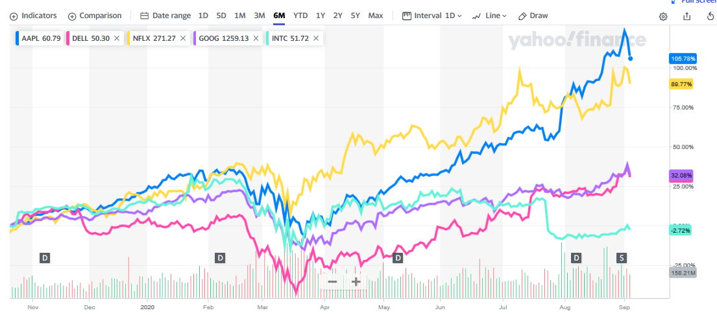
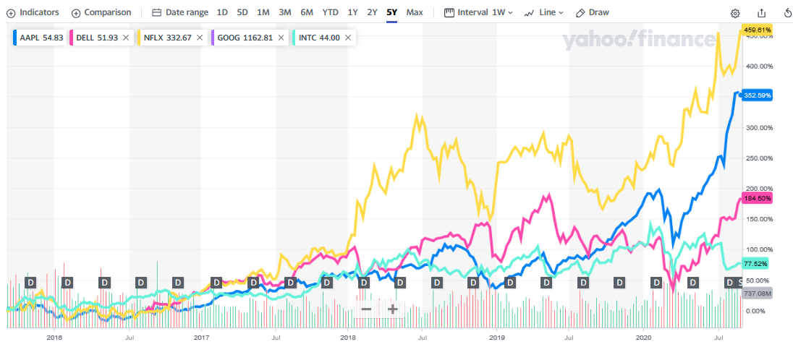
When we look at share price growth we note that apple and Netflix have shown significant growth over last 5 years as well as over last six months

Slide 8
Conclusion
Netflix has shown strong growth in terms of net profit, Gross profit, Total cash and total assets over the last one year compared to other companies.
Net profit, Gross profit , Total cash and total assets have grown steadily over last 4 years for Netflix.
Apart from this there is steady growth in the stock price for Netflix specifically over last one month.
So at the end of our analysis we conclude that Netflix will be a good stock to invest the money over the period of next 1 year

